Slide 1

Model Predictive Control
林學謙

Slide 2
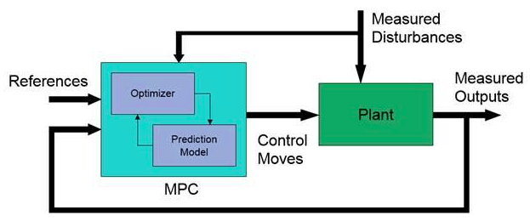
MPC basic control loop

Slide 3
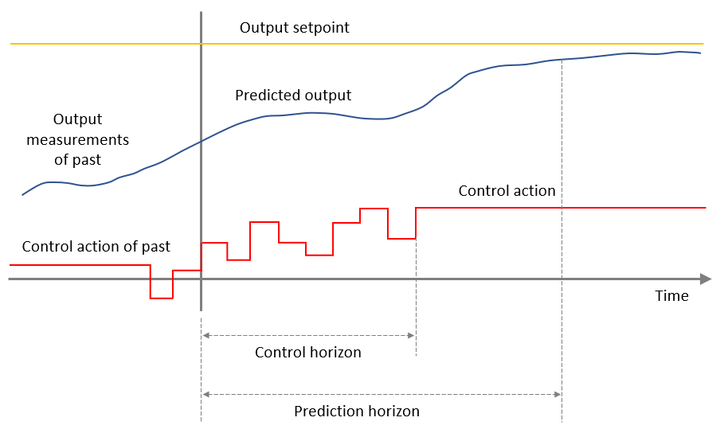
MPC model

Slide 4
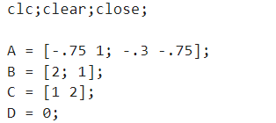

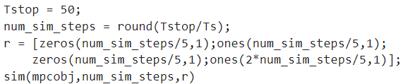
Code explanation

Slide 5

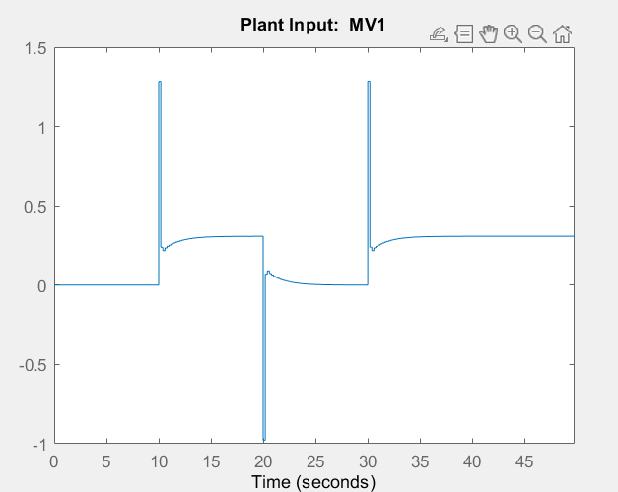
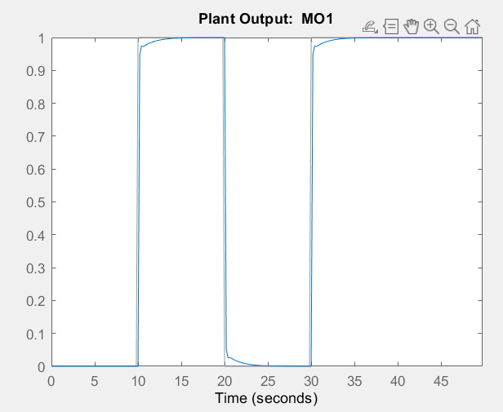
Result

Slide 6
References
https://www.mathworks.com/help/mcb/gs/run-foc-pmsm-using-model-predictive-control.html
https://www.mathworks.com/help/mpc/gs/what-is-mpc.html

